Slide 1
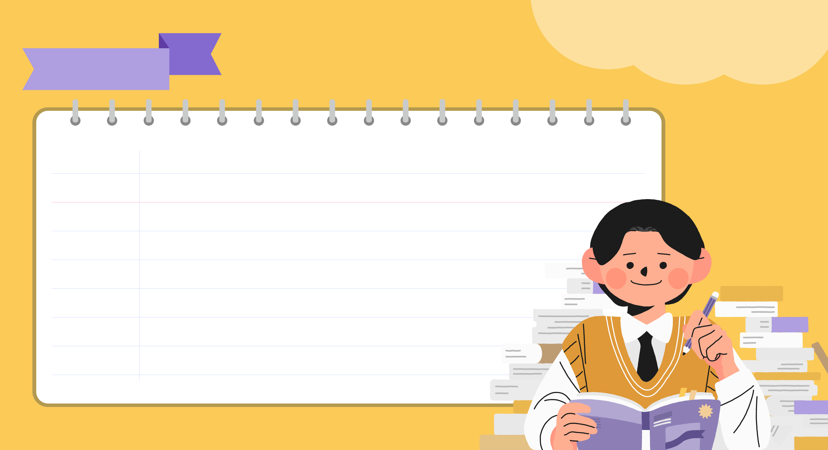
Middle School
ENGLISH 1
01
Lesson
Ready for a New Start

Slide 2


Our First Day of School
Lesson 01
This is me on my first day of school. And this is my favorite picture of my mom. Her uniform is cool. Now, I wear a uniform just like her. We wear the same blue tie!
┌ be동사의 3인칭 단수형: is
이것은 ~이다
소유격(I-my-me)
[전] ~의
[접] 그리고
[형] 좋아하는
나의 엄마의 사진
소유격(she-her-her)
[형] 멋있는
일반동사의 1인칭 단수형:
동사원형
[부] 딱
[전] ~처럼, ~와 같은
[형] 같은

Slide 3
Our First Day of School
Lesson 01
I have six classes today. Do I have all my textbooks?
Yes, I do. Oh, no! My pencil case isn’t in my bag. I check my bag again and again. Oh, it’s on my desk. My first class starts at 9:00 a.m. Oops, it’s already 8:50 a.m.!
class의 복수형
일반동사의 의문문: Do + 주어 + 동사원형 ~?
일반동사 의문문의 답
be동사의 부정문 is not의 축약형
반복하여
3인칭 단수 주어와 be동사 it is의 축약형
일반동사의 3인칭 단수형: 동사원형+s
비인칭주어(시간)

Slide 4
Our First Day of School
Lesson 01
The bell rings. It’s music class. I run to the music room. I sit on a chair. Someone calls my name. It’s my older sister. Wait! Am I in my sister’s class? I don’t see my classmates. Where is my music room?
일반동사의 3인칭 단수형: 동사원형+s
일반동사의 1인칭 단수형: 동사원형
일반동사의 3인칭 단수형: 동사원형+s
= Someone
be동사의 의문문: be동사 + 주어 ~?
일반동사의 부정문: don’t[doesn’t]+동사원형
be동사가 쓰인 의문사 의문문: 의문사+be동사+주어 ~?

Slide 5

Ready for a New Start
Lesson 01
be동사
I am(=I’m) 14 years old.
You are(=You’re) my best friend.
My brother is very tall.
We are(=We’re) very busy now.
The books are on the table.
돌아가기

Slide 6
Ready for a New Start
Lesson 01
be동사
I am(=I’m) 14 years old.
You are(=You’re) my best friend.
My brother is very tall.
We are(=We’re) very busy now.
The books are on the table.
돌아가기

Slide 7
Ready for a New Start
Lesson 01
be동사 부정문
I am not sick.
He is not(=isn’t) a police officer.
They are not(=aren’t) hungry.
This is not(=isn’t) my smartphone.
Jim and Sue are not(=aren’t) late for school.
돌아가기

Slide 8
Ready for a New Start
Lesson 01
be동사 부정문
I am not sick.
He is not(=isn’t) a police officer.
They are not(=aren’t) hungry.
This is not(=isn’t) my smartphone.
Jim and Sue are not(=aren’t) late for school.
돌아가기

Slide 9
Ready for a New Start
Lesson 01
be동사 의문문
Am I right? ─ Yes, you are. / No, you aren’t.
Are you tired? ─ Yes, I am. / No, I’m not.
Is Kevin at home? ─ Yes, he is. / No, he isn’t.
Is the movie interesting? ─ Yes, it is. / No, it isn’t.
Are your parents busy? ─ Yes, they are. / No, they aren’t.
Who are they? ─ They are ….
돌아가기

Slide 10
Ready for a New Start
Lesson 01
일반동사
I live in Seoul.
You have brown hair.
He likes computer games.
The shop opens at 9 in the morning.
Jack and Danny play soccer after school.
돌아가기

Slide 11
Ready for a New Start
Lesson 01
일반동사
I live in Seoul.
You have brown hair.
He likes computer games.
The shop opens at 9 in the morning.
Jack and Danny play soccer after school.
돌아가기

Slide 12
Ready for a New Start
Lesson 01
일반동사
I live in Seoul.
You have brown hair.
He likes computer games.
The shop opens at 9 in the morning.
Jack and Danny play soccer after school.
돌아가기

Slide 13
Ready for a New Start
Lesson 01
일반동사의 부정문
I do not(=don’t) like fish.
He does not(=doesn’t) like a horror movie.
We do not(=don’t) have much money.
My friend does not(=doesn’t) eat vegetables.
Sora and her brother do not(=don’t) have a pet.
돌아가기

Slide 14
Ready for a New Start
Lesson 01
일반동사의 의문문
Do you take a bus to school? ─ Yes, I do. / No, I don’t.
Does she run every day? ─ Yes, she does. / No, she doesn’t.
Does the concert finish at 9 p.m.? ─ Yes, it does. / No, it doesn’t.
Do they change their plan? ─ Yes, they do. / No, they don’t.
Why do you want to be a soccer player? ─ Because I ….
돌아가기

Slide 15

Thank You!

